Slide 1

CODING- DECODING

Slide 2
Coding is a process used to encrypt a word, a number in a particular code or pattern based on some set of rules. Hence Coding is the process of sending data from one person to another person in such a way that only the sender and receiver can understand the meaning without letting anyone else know the meaning of it. Decoding It is the reverse process of converting the coded information back into original form understandable by a receiver. Hence, decoding is the process of converting the coded data back into original form by applying the process of coding but in reverse process.

Slide 3
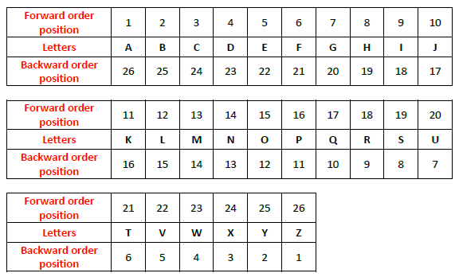
The alphabet order and EJOTY concept: By using this concept, we can easily remember the position of different alphabets and accordingly find out any letter without much effort. All we have to do is remember the place of these five letters which are mentioned below: E → 5 J → 10 O → 15 T → 20 Y → 25

Slide 4
TYPES OF CODING
1. Letter coding
2. Number Coding
3. Substitution coding
4. Deciphering Coding
5. Coding by combinations of letters, Nos. and Symbols

Slide 5
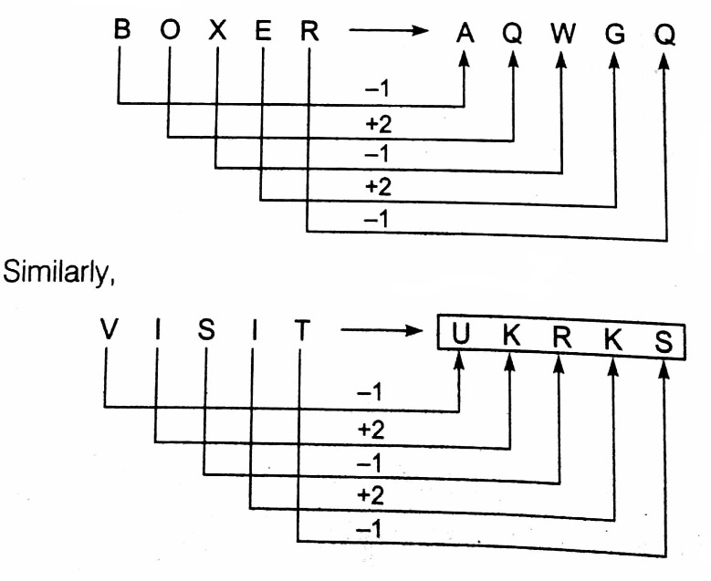
Letter Coding In this, we are going to deal with the types of questions, in which the letter of a word are replaced by certain other letters according to a specific pattern/rule to form a code. Example. In a certain code language ‘BOXER’ is written as ‘AQWGQ’. What will be the code of ‘VISIT’ in that code language? Solution: UKRKS

Slide 6
1. In a certain code language COMPUTER is written as RFUVQNPC. How will MEDICINE be written in that code language? A) EOJDJEFM B) MFEDJJOE C) MFEJDJOE D) EOJFJEFM
Coding-Decoding
Notes:
Correct answer: A

Slide 7
2. In a certain code 'CERTAIN' is coded as 'BFQUZJM'. How is 'MUNDANE' coded in that code?? A) LTMCZOF B) LVMEZOD C) NTOCNBF D) None of these
Coding-Decoding
Notes:
Correct answer: B

Slide 8
Coding-Decoding
3. In a certain code 'SEQUENCE' is coded as 'FDOFVRFT. How is 'CHILDREN' coded in that code?
A) OFESMJID
B) OFSEJMID
C) OFSEMJID
D) OFSMEJID
Notes:
Correct Option: C

Slide 9
Coding-Decoding
4. In certain code 'HILTON' is written as 'I H T L N O'. How is 'BILLION' written in that code?
A) IBLLOIN
B) IBOILLN
C) IBOILNL
D) IBOLLIN
Notes:
Correct Option: A

Slide 10
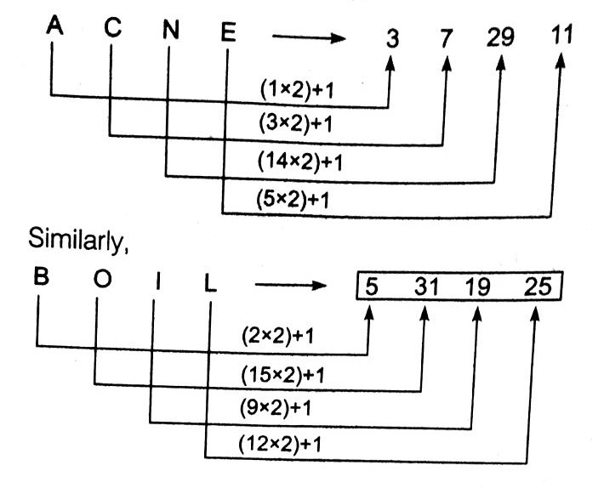
Number Coding In this, we are going to deal with the questions, in which the numerical code values are assigned to a word or alphabets according to predefined pattern. Example. If ‘ACNE’ is coded as 3 7 29 11, then what will be code for ‘BOIL’ in that code language? Solution: 5 31 19 25

Slide 11
Coding-Decoding
5. If REQUEST is written as S2R52TU, then how will ACID be written?
A) 1DJE
B) 1C3F
C) 1D3E
D) 1D2F
Notes:
Correct Option: C

Slide 12
6. If each of the letters in the English alphabet is assigned odd numerical value beginning A = 1, B = 3 and so on, what will be the total value of the letters of the word INDIAN? A) 86 B) 88 C) 89 D) 96
Notes:
Correct answer: D

Slide 13
7. If A = 2, M = 26, Z = 52, then BET = ? A) 45 B) 54 C) 64 D) 72
Notes:
Correct answer: B

Slide 14
Coding-Decoding
8. DEER = 12215 and HIGH = 5654, how will you code HEEL?
A) 4337
B) 2328
C) 3449 D) 5229
Notes:
Correct Option: D

Slide 15
Coding-Decoding
9. If UNIVERSITY is 1273948756, how can TRUSTY be written in that code? A) 541956
B) 531856
C) 541856
D) 531956
Notes:
Correct Option: C

Slide 16
Coding-Decoding
10. If in a certain code, 15789 is written as EGKPT and 2436 is written as ALUR, then how will 24539 be written in that code?
A) ALGRT
B) ALGUT
C) ALEUT
D) ALGTU
Notes:
Correct Option: B

Slide 17
Substitution Coding: In such question, we are going to deal with the pattern of coding in which codes are assigned by the substitution method where in an artificial alternative is assigned to a given word and students are required to decipher the coding pattern to substance the other given word. Example. If yellow is called blue, blue is called red, red is called pink, pink is called black and black is called orange, then what is the colour of blood? Solution: We know, colour of blood = red But according to question, Red = pink, Therefore, the colour of blood = pink

Slide 18
Coding-Decoding
11. If ‘cook’ is called ‘butler’, ‘butler’ is called ‘manager’, ‘manager’ is called ‘teacher’, ‘teacher’ is called ‘clerk’ and ‘clerk’ is called ‘principal’, who will teach in a class?
A) Cook
B) Butler
C) Manager
D) Clerk
Notes:
Correct Option: D

Slide 19
Coding-Decoding
12. If ‘eye’ is called ‘hand’ , ‘hand’ is called ‘mouth’, ‘mouth’ is called ‘ear’, ‘ear’ is called ‘nose’ and ‘nose’ is called ‘tongue’, with which of the following would a person hear?
A) Ear
B) Nose
C) Eye
D) Tongue
Notes:
Correct Option: B

Slide 20
Coding-Decoding
13. If `bat' is 'racket', 'racket' is 'football', 'football' is 'shuttle', 'shuttle' is 'Ludo' and Ludo is ‘carrom’, what is cricket played with ?
A) Football
B) Racket
C) Bat
D) Cannon
Notes:
Correct Option: B

Slide 21
Deciphering Coding: In these types of question, we are going to deal with a message bearing a common code for given word/numeral. Students are required to identify the code from the common property of word/numeral and decipher the given codes with best alternatives. Example. In a certain language, 'sun shines brightly' is written as ‘ba lo sul’, 'houses are brightly lit' as ‘kado ula ariba’ and 'light comes from sun' as ‘dopikup lo nro’. What is the code for sun and brightly? Solution: In the first and third statements, the common word is 'sun' and the common codeword is ‘lo’. So, ‘lo’ is the code for 'sun'. In the first and second statements, the common word is 'brightly' and the common code word is ‘ba’. So, ‘ba’ is the code for 'brightly'.

Slide 22
Coding-Decoding
14. In a certain code language ‘Pen pencil’ is written as ‘$£’, ‘eraser sharpener’ is written as ‘@#’ and ‘pencil eraser’ is written ‘$@’. Then, what is the code for ‘pen’ ?
A) #
B) $
C) £
D) @
Notes:
Correct Option: C

Slide 23
Coding-Decoding
15. In a certain code language ‘123’ means ‘hot filtered coffee’. ‘356’ means ‘very hot day’ and ‘589’ means ‘day and night’. Which digit stands for ‘very’?
A) 9
B) 8
C) 6
D) 5
Notes:
Correct Option: C

Slide 24
Coding-Decoding
In a certain code language,
‘good time to buy’ is written as ‘sy bo nj kw’
‘invest money and time’ is written as ‘sy ta ge mr’.
‘buy good stuff only’ is written as ‘kw bo rd fp’.
‘only work and money’ is written as ‘ta fp mr ux’.
16. What is the code for “invest time to work” in the give code language?
A) sy bo mr fp
B) ta fp ux nj
C) mr sy bo ta
D) ux ge nj sy
Notes:
Correct Option: D

Slide 25
Coding-Decoding
In a certain code language,
‘good time to buy’ is written as ‘sy bo nj kw’
‘invest money and time’ is written as ‘sy ta ge mr’.
‘buy good stuff only’ is written as ‘kw bo rd fp’.
‘only work and money’ is written as ‘ta fp mr ux’.
17. What is the for “stuff” in the given code language?
A) bo
B) kw
C) Either ‘bo’ or ‘rd’
D) rd
Notes:
Correct Option: D

Slide 26
Coding-Decoding
In a certain code language,
‘good time to buy’ is written as ‘sy bo nj kw’
‘invest money and time’ is written as ‘sy ta ge mr’.
‘buy good stuff only’ is written as ‘kw bo rd fp’.
‘only work and money’ is written as ‘ta fp mr ux’.
18. What is the code for “only time and money” in the given code language?
A) bo nj ta ge
B) mr ta sy fp
C) ge fp ta bo
D) sy bo ux fp
Notes:
Correct Option: B

Slide 27
Coding-Decoding
In a certain code language,
‘good time to buy’ is written as ‘sy bo nj kw’
‘invest money and time’ is written as ‘sy ta ge mr’.
‘buy good stuff only’ is written as ‘kw bo rd fp’.
‘only work and money’ is written as ‘ta fp mr ux’.
19. What is the code for “buy good” in the given code language?
A) rd nj
B) kw bo
C) kw nj
D) can’t be determine
Notes:
Correct Option: B

Slide 28
Coding-Decoding
In a certain code language,
‘good time to buy’ is written as ‘sy bo nj kw’
‘invest money and time’ is written as ‘sy ta ge mr’.
‘buy good stuff only’ is written as ‘kw bo rd fp’.
‘only work and money’ is written as ‘ta fp mr ux’.
20. What is the code for “to” in the given code language?
A) nj
B) ge
C) kw
D) sy
Notes:
Correct Option: A

Slide 29
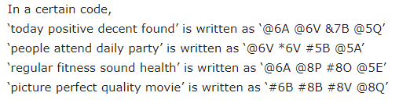
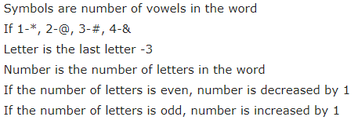
Coding by combinations of letters, Nos. and Symbols: Example Solution: @8Q

Slide 30
In a certain code language, ‘Earth Laughs With Flowers’ is written as ‘$G20 %G18 %I15 $S21’ ‘Become What You Believe’ is written as ‘%E12 %L21 $Z1 $N3’ ‘Reach Your Own Stars’ is written as ‘$F21 %I1 %D14 %X1’ 21. What is the code of the word ‘Wisdom’? A) %D19 B) $L19 C) $O19 D) None of these
Coding-Decoding
Notes:
Correct answer: Option B

Slide 31
In a certain code language, ‘Earth Laughs With Flowers’ is written as ‘$G20 %G18 %I15 $S21’ ‘Become What You Believe’ is written as ‘%E12 %L21 $Z1 $N3’ ‘Reach Your Own Stars’ is written as ‘$F21 %I1 %D14 %X1’ 22. ‘$Z1’ is the code for which of the following word? A) Own B) Reach C) Your D) Star
Coding-Decoding
Notes:
Correct answer: Option D

Slide 32
In a certain code language, ‘Earth Laughs With Flowers’ is written as ‘$G20 %G18 %I15 $S21’ ‘Become What You Believe’ is written as ‘%E12 %L21 $Z1 $N3’ ‘Reach Your Own Stars’ is written as ‘$F21 %I1 %D14 %X1’ 23. What is the code of the word ‘Imagination’? A) $Z15 B) $L1 C) %L1 D) %G13
Coding-Decoding
Notes:
Correct answer: Option C

Slide 33
In a certain code language, ‘Earth Laughs With Flowers’ is written as ‘$G20 %G18 %I15 $S21’ ‘Become What You Believe’ is written as ‘%E12 %L21 $Z1 $N3’ ‘Reach Your Own Stars’ is written as ‘$F21 %I1 %D14 %X1’ 24. What is the code of ‘Dreams Humanity’ in the given code language? A) $N5 $G13 B) %G13 %N5 C) $R8 %T17 D) $M5 %H14
Coding-Decoding
Notes:
Correct answer: Option A

Slide 34
Coding-Decoding
25. In a certain coded language, ABC means ‘ You are lost’. Which letter stands for ‘You’?
OBM means ‘ We are classmates’.
CLR means ‘ You love them’.
OA means ‘ Hello lost’
A) Only III
B) Only I and III
C) All I, II and III
D) None of these
Notes:
Correct Option: D

Slide 35
Coding-Decoding
26. In a certain code language ‘176’ mean tie clip button. Which number represents the word ‘button’ in that language
In the same language, ‘175’ mean ‘clip your tie’.
In the same language, ‘074’ mean ‘hole and clip’
A) Only I
B) Only II
C) Both I and II required
D) Both I and II are not required
Notes:
Correct Option: A

Slide 36
Any Doubts???

